Slide 1
Mini Project II
By Annoj Jeyalingam

Slide 2
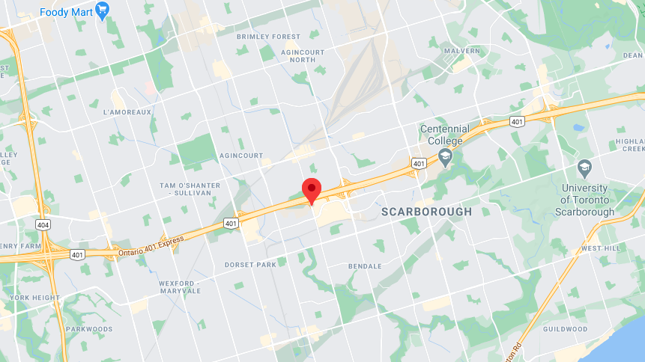
Coordinates
43.7777875391617,-79.26400584572922

Slide 3
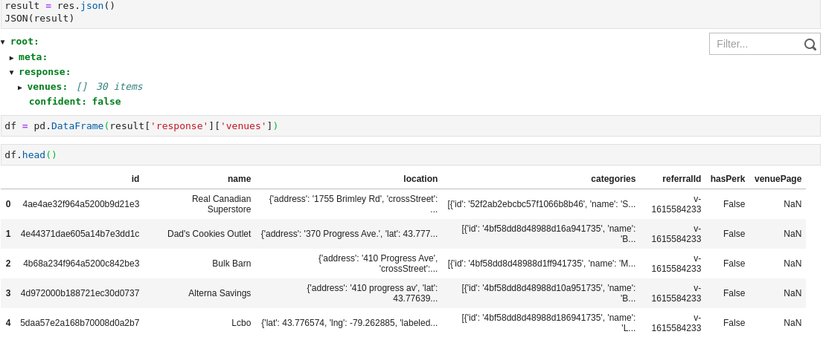
FourSquare

Slide 4
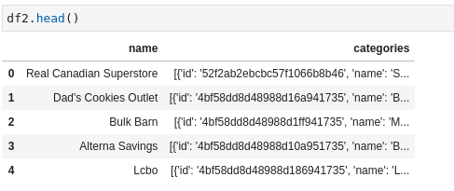

Slide 5
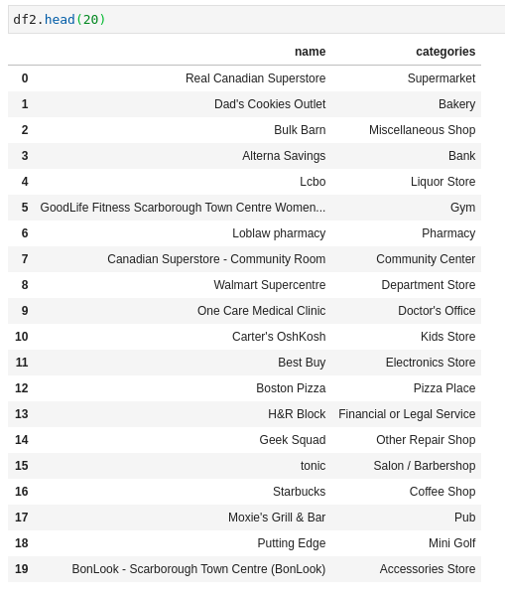

Slide 6
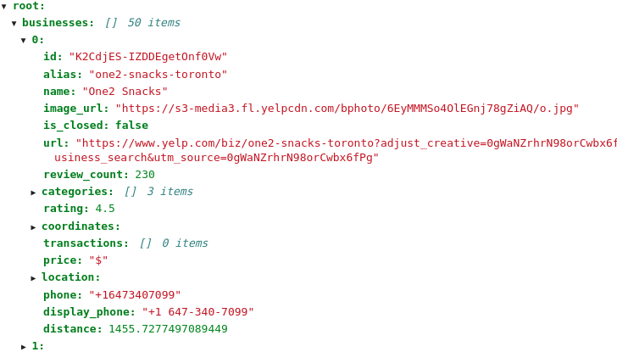

Yelp

Slide 7


Slide 8
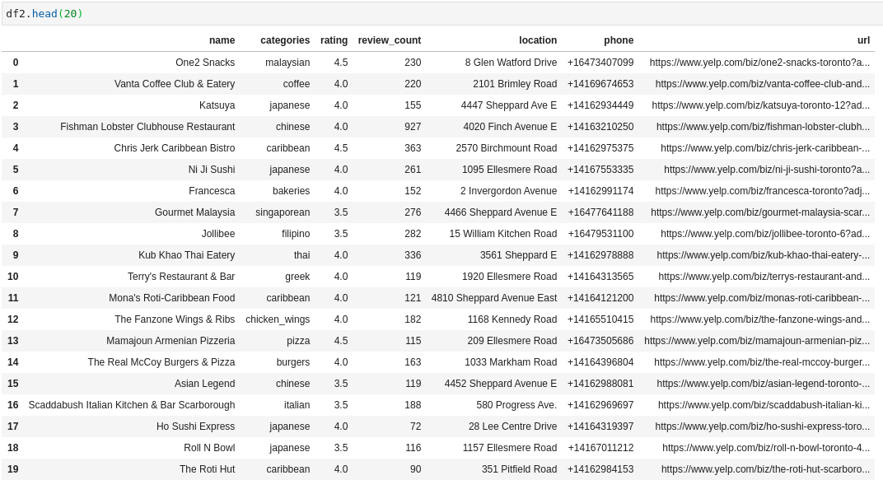

Slide 9


Slide 10



